Slide 1

Trashman.co
Join for a change.

Slide 2

Introduction
Trashman.co is corporation that established based on the anxiety towards community.

Slide 3



Trashman.co Founder

Slide 4
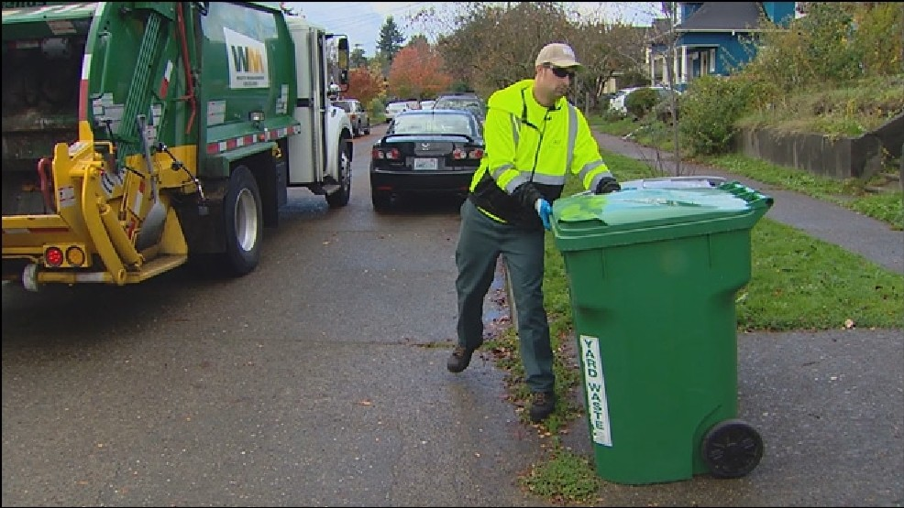
Our objective
Engaged in cleaning sector, trashman have so many hope to make an utopia for out next generation.

Slide 5
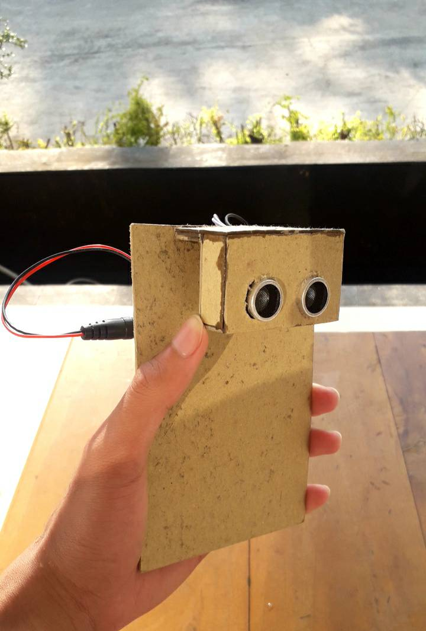
Our product
Introducing Trashman I make your daily activity more fantastic, by giving you feedback for each trash you throw.

Slide 6
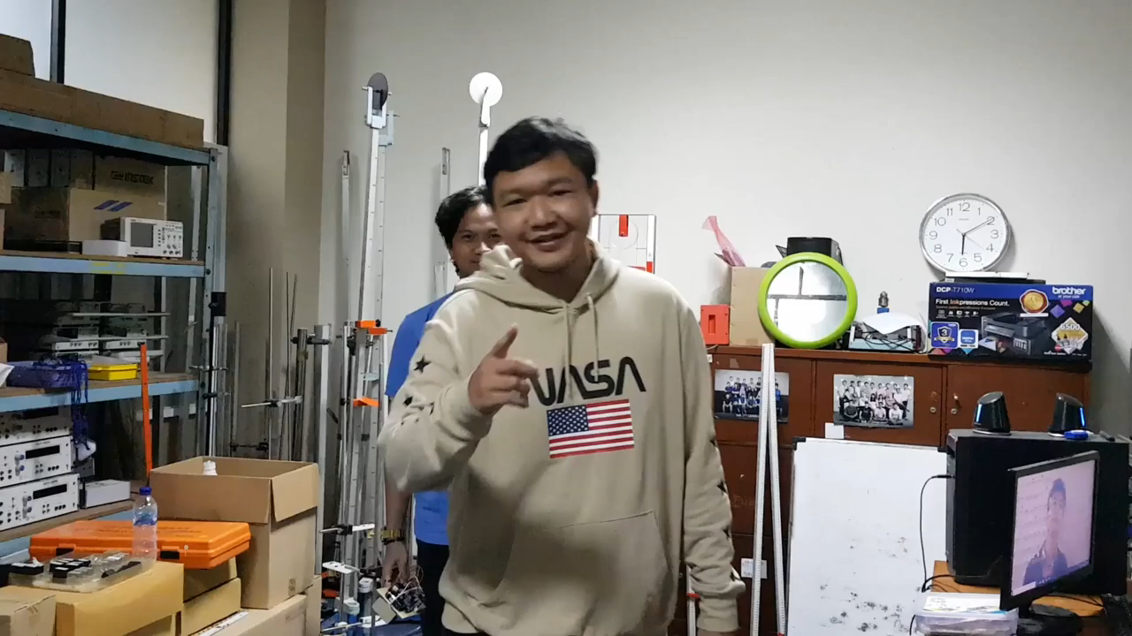
Trailer and promotion

Slide 7

DEMO

Slide 8
Contact us and give them hope.
Website : http://trashman.azurewebsites.net/

